Slide 1
team saggezza
Rare Disease Hackathon 2021
Eangelica Aton, Baran Cetin, Alara Kuturman, Pashmi Hasara Dellakkada Liyanage, Zeynep Devrim Ozenc

Slide 2
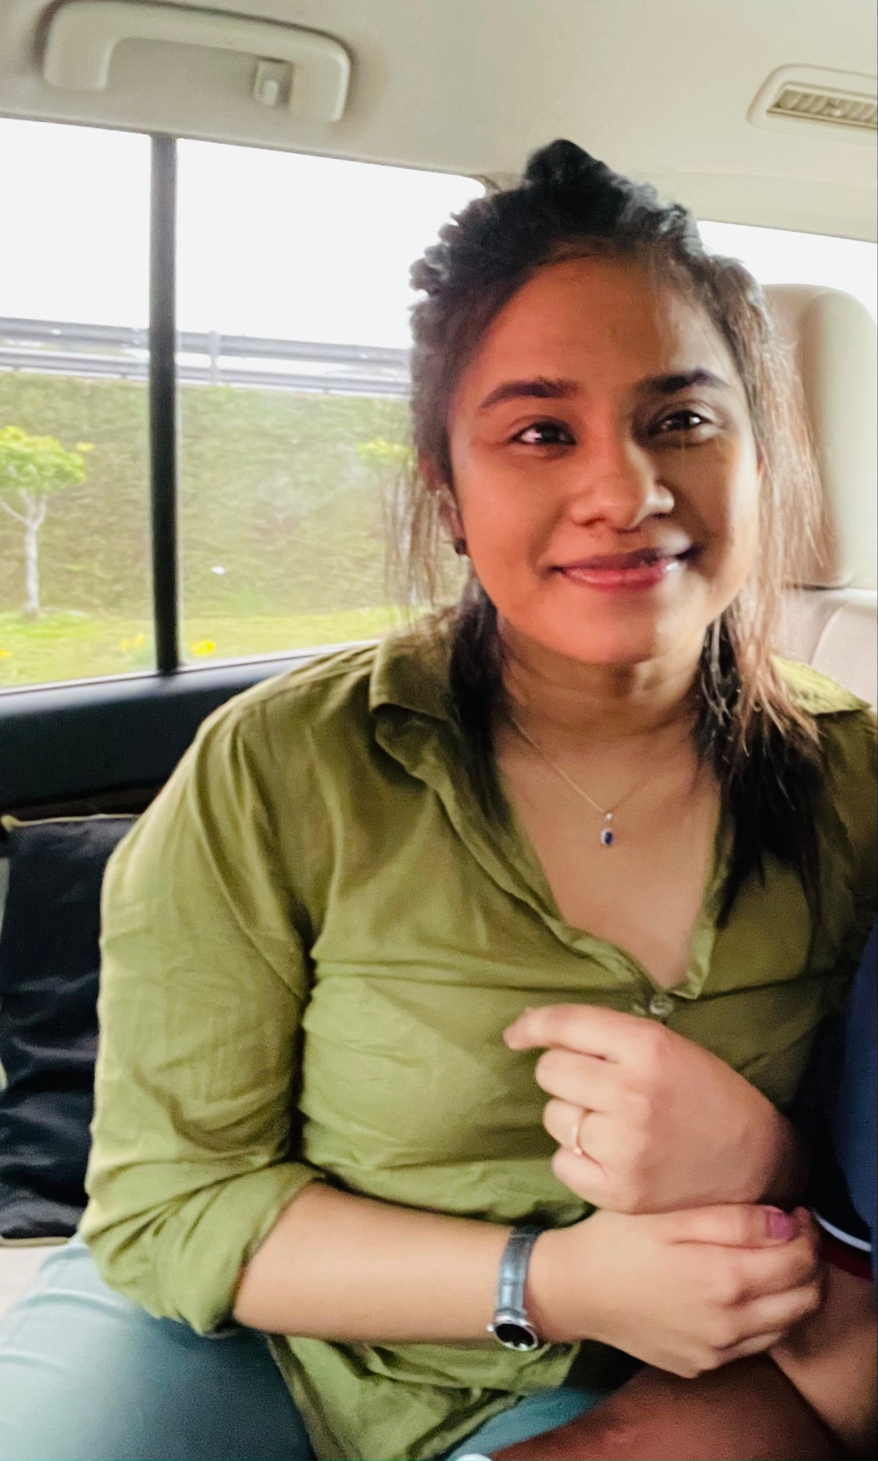
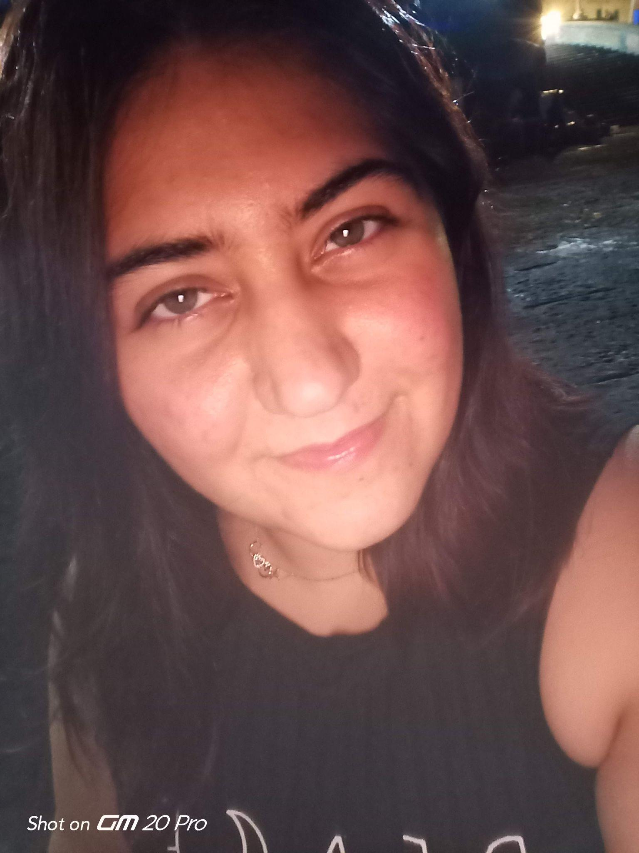
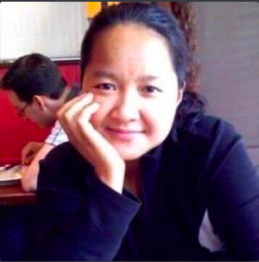
Presenting team:
Eangelica Aton
Stanford University
& Luigi Vanvitelli Medical,Naples,Italy,
Product Manager, MD
Candidate
Pashmi Hasara Dellakkada Liyanage
Luigi
Vanvitelli Medicine and Surgery, Naples, Italy
Baran Cetin
İsik
University Mechatronic Engineering, İstanbul, Turkey
Alara Kuturman
Federico II
Medicine and Surgery, Naples, Italy
Zeynep Devrim Ozenc
Luigi
Vanvitelli Medicine and Surgery, Naples, Italy

Slide 3
Rare Disease of Interest:DIPG (Diffuse Intrinsic Pontine Glioma)
General Info on DIPG:
Brainstem malignancy ,more common in children
< 1-year survival on average
In urgent need of curative interventions
End-Stage symptoms; impairments with mobility and swallowing, inability to communicate, breathe or stay conscious

Slide 4


Meet Isabelle and her family
Isabelle’s family needed to find emotional and parental support about DIPG which could be filtered by zip code, language, mobility, rehabilitation after radiation therapy and most of all Motivational Tips
Notes:
https://www.facebook.com/groups/234600751237957

Slide 5
Understanding Effects of DIPG :
Lack of Emotional Support: Loss of physical /cognitive abilities is disempowering for children who are patients seeking for understanding
1)
Lack of Research: The disease being rare and not much information being available, most families are uninformed about their child’s status
2)
Caregiving Hardships: Becoming a caregiver is a challenging duty with emotional /psychological needs to be fulfilled in order to effectively carry on the duty
3)

Slide 6
What Could Be Done?

Slide 7

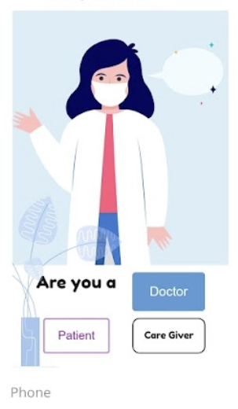
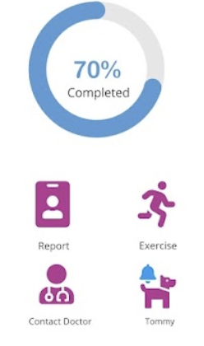
The Saggezza Solution:
Our main aim is to launch a website/Application to eliminate these points as much as possible:
DIPG
Notes:
GitHub Link - https://github.com/eangelica2014/TeamSaggezza

Slide 8
Memory making
Assessment of health related quality of life by Pediatric Quality of Life Inventory
Addition of features to exercise impaired functions
Coping strategy tips
Funding campaigns
Daily/Weekly/Monthly Questioners
Educative Videos for Children
Reduced time spent in the hospitals
Reduced hospital fees
More children having the possibility of getting therapy due to reduced fees
Formation of the website/app
Further Utilization by the hospitals
Emotional Support for the patient
Informative Support
Caregiver Support
Reduced patient burden on hospitals
Ability to control patients remotely
Less chance of contamination of other pathogens to children getting radiotherapy
Educative youtube videos or blog articles from specialists in the field
Meeting with families with similar conditions to exchange information
Staying confidential but connected to community

Slide 9
1)To Provide Necessary Emotional Support To Children:
Making Memories: This could allow the child and the family to feel disease free and adapted to ‘Normal Life’ laughing and playing together in the hospital or in their houses
- Via using apps such as Reface/ etc.
- By giving them daily missions to complete to make the child more integrated to the family and let the child take more responsibility(Making a puzzle/Cooking together/Counting cars on the road etc.)
Notes:
We could explain every point like this, but it would take a lot of time. I just left the sample here, we can further do explanations of the points or we can just talk about them. However you guys prefer.

Slide 10
THANK YOU FOR YOUR TIME

Slide 11
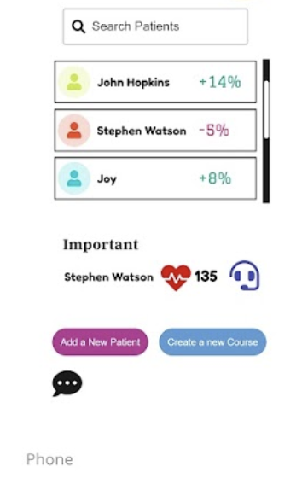
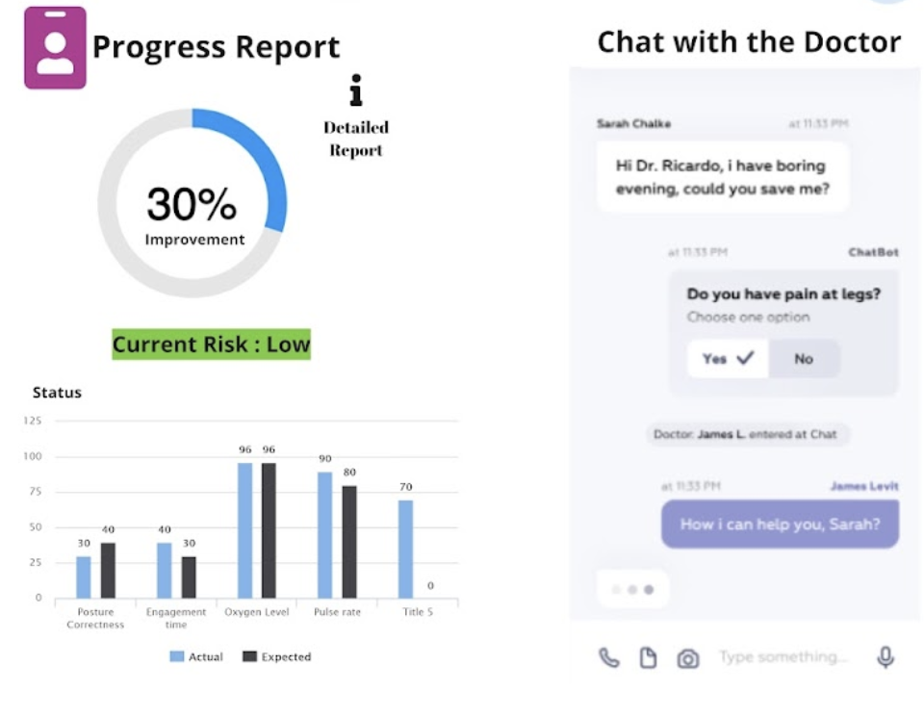
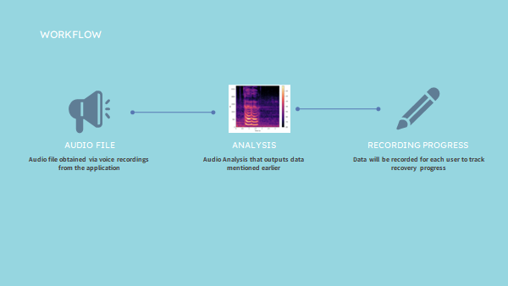
Appendix

Slide 12
References:
Hoffman, L. M., Veldhuijzen van Zanten, S. E. M., Colditz, N., Baugh, J., Chaney, B., Hoffmann, M., Lane, A., Fuller, C., Miles, L., Hawkins, C., Bartels, U., Bouffet, E., Goldman, S., Leary, S., Foreman, N. K., Packer, R., Warren, K. E., Broniscer, A., Kieran, M. W., … Fouladi, M. (2018). Clinical, radiologic, pathologic, and molecular characteristics of long-term survivors of diffuse intrinsic pontine glioma (DIPG): A collaborative report from the International and European Society for Pediatric Oncology DIPG registries. Journal of Clinical Oncology, 36(19), 1963–1972. https://doi.org/10.1200/jco.2017.75.9308
Martínez-Vélez, N., Garcia-Moure, M., Marigil, M., González-Huarriz, M., Puigdelloses, M., Gallego Pérez-Larraya, J., Zalacaín, M., Marrodán, L., Varela-Guruceaga, M., Laspidea, V., Aristu, J. J., Ramos, L. I., Tejada-Solís, S., Díez-Valle, R., Jones, C., Mackay, A., Martínez-Climent, J. A., García-Barchino, M. J., Raabe, E., … Alonso, M. M. (2019). The oncolytic virus delta-24-RGD elicits an antitumor effect in pediatric glioma and DIPG Mouse models. Nature Communications, 10(1). https://doi.org/10.1038/s41467-019-10043-0
Veldhuijzen van Zanten, S. E., van Meerwijk, C. L., Jansen, M. H., Twisk, J. W., Anderson, A. K., Coombes, L., Breen, M., Hargrave, O. J., Hemsley, J., Craig, F., Cruz, O., Kaspers, G. J., van Vuurden, D. G., Hargrave, D. R., & SIOPE DIPG Network (2016). Palliative and end-of-life care for children with diffuse intrinsic pontine glioma: results from a London cohort study and international survey. Neuro-oncology, 18(4), 582–588. https://doi.org/10.1093/neuonc/nov250
Mandrell, B. N., Baker, J., Levine, D., Gattuso, J., West, N., Sykes, A., Gajjar, A., & Broniscer, A. (2016). Children with minimal chance for cure: Parent proxy of the child’s health-related quality of life and the effect on parental physical and mental health during treatment. Journal of Neuro-Oncology, 129(2), 373–381. https://doi.org/10.1007/s11060-016-2187-9

